Slide 1
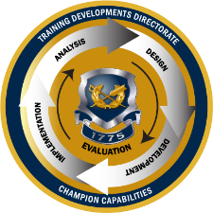
TJAGLCS Training Package
Unauthorized Commitments and Ratification
December 2024

Slide 2
The information provided throughout this training aid does not, and is not intended to, constitute legal advice; instead, all information, laws, statues, content, and materials for this training aid are for general informational purposes only. This training aid may not constitute the most up-to-date legal or other relevant legal information. Judge Advocates need to conduct their own due diligence through independent further legal research on any specific legal issue contained in this training package. No reader, user, or trainee of this product should act or refrain from acting based on information from this training aid without first seeking legal advice from an attorney in the relevant jurisdiction.

Slide 3
Unauthorized Commitments and Ratification

Slide 4
What is an unauthorized commitment (UAC)?
FAR 1.602-3; AFARS 5101.602-90

Slide 5
What is an example of a UAC?
AFARS, Chapter 14, Section 14-2

Slide 6
What steps to take if a UAC occurs?
Ratification: an act to approve the UAC by an official who has the authority to do so
Agencies should process UAC’s using the ratification authority in FAR 1.602-3 instead of referring such actions to the Government Accountability Office for resolution OR
UAC’s that would involve claims subject to resolution under the Contract Disputes Act should be processed in accordance with FAR 33.2, Disputes and Appeals
FAR 1.602-3(b) & (c); FAR 33.2

Slide 7
Can we ratify the UAC?
IF the ratifying government official has actual or constructive knowledge of a representative’s unauthorized act and expressly or impliedly adopts the act, ratification has been found
Knowledge: “Where an agent has acted without authority …ratification can only be based upon full knowledge of all the facts upon which the unauthorized action was taken. Knowledge is necessary in any event.” (United States v. Beebe, 180 U.S. 343 (1901))
FAR 1.602-3(b) & (c); AFARS 5101.602-90

Slide 8
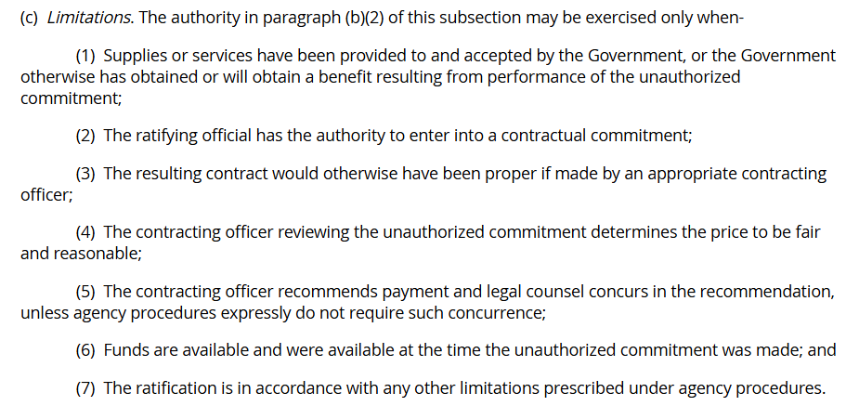
Ratification: elements that must exist
FAR 1.602-3(c)

Slide 9
Need Training Materials?
Have Training Materials?
Questions?
Contact Us!
TJAGLCS-training@army.mil

